Slide 1

TIME
GYM
FOR
Ross Stewart & James Johnson

Slide 2
Concept
Gym too crowded? Don’t know what exercises to do in the gym? Want to try something new?
This app will serve as an interactive database for exercises and a way of viewing the gym crowdedness before going there
This app will provide the current capacity of the gym, and an estimated wait time for each exercise
This app will also provide a list of exercises for each muscle group and provide a description and instructions
Concerned that you’re going to do an exercise wrong?
Each exercise will link a “how-to video” to make sure that they are done correctly and with proper form

Slide 3
Functional Requirements
Sign Up
Log In
Create User Profile
View Home Page
View Exercises By Muscle Group
View Individual Exercise
View Favorite Exercises
View Gym Crowd Level
Log Out

Slide 4
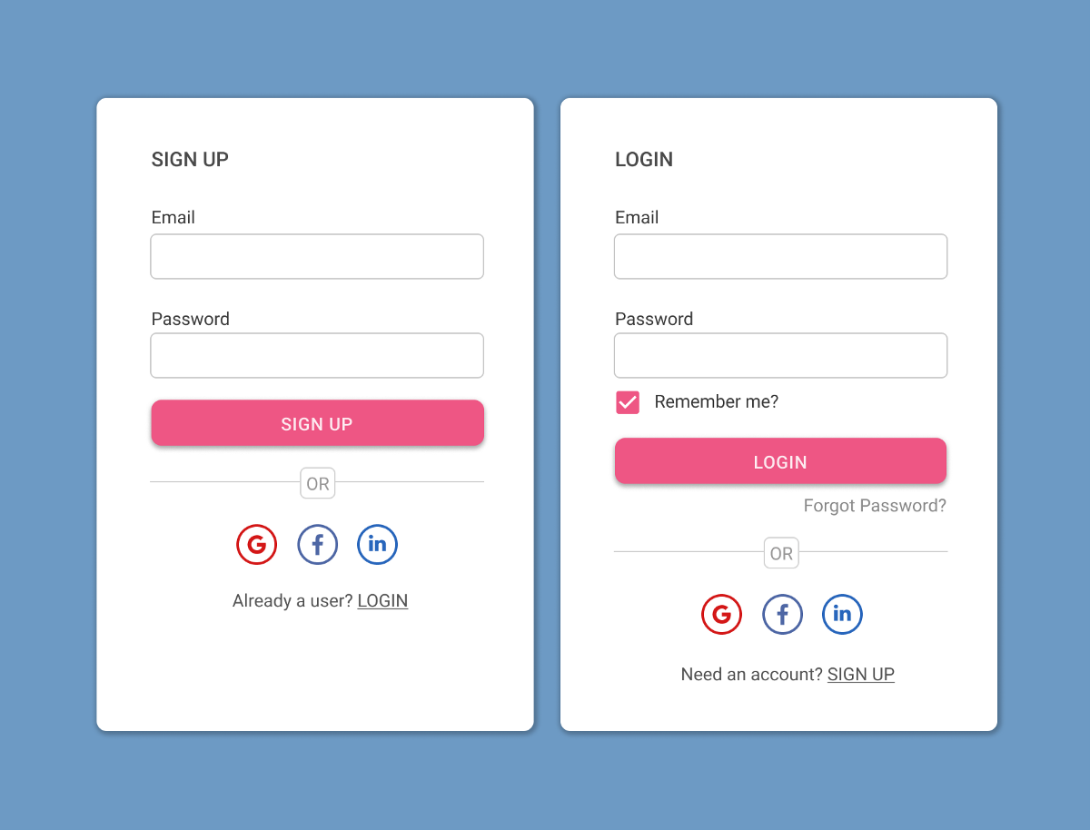
Functional Requirement - Sign Up
Precondition: Email, phone number, or Google account
Basic flow: User opens application ⇒ User is prompted to sign up or log in ⇒ First time user click sign up ⇒ User is redirected to third party to enter information for account
Postcondition: User profile is then created ⇒ user prompted to save login info

Slide 5
Functional Requirement - Log In
Precondition: The user must have a working account
Basic flow: User opens application ⇒ User is prompted to sign up or log in ⇒ User clicks log in ⇒ User is redirected to third party to enter login information
Postcondition: The user is directed to the home page

Slide 6
Functional Requirement - Create User Profile
Precondition: Sign up
Basic Flow: The user signs up ⇒ An account is made for the user ⇒They are initialized to have no favorite exercises
Postcondition: Redirected to login page

Slide 7
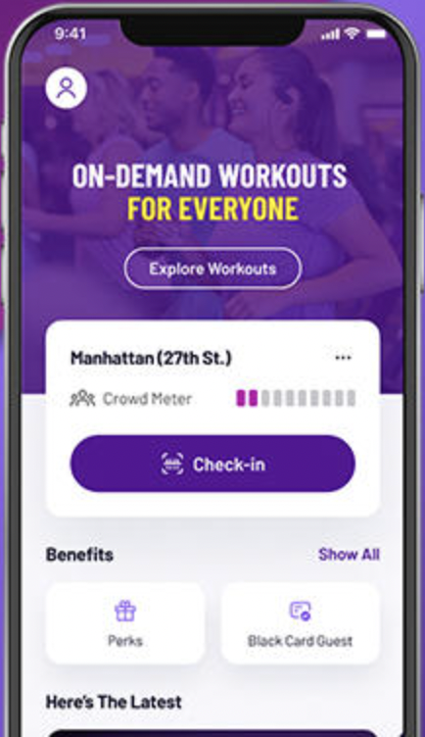
Functional Requirement - View Home Page
Precondition: Log in
Basic Flow: The user logs in and is directed to the home page ⇒The user can view exercises by muscle group, view gym crowdedness, and view favorite exercises
Postcondition: Different options at the home page are available

Slide 8
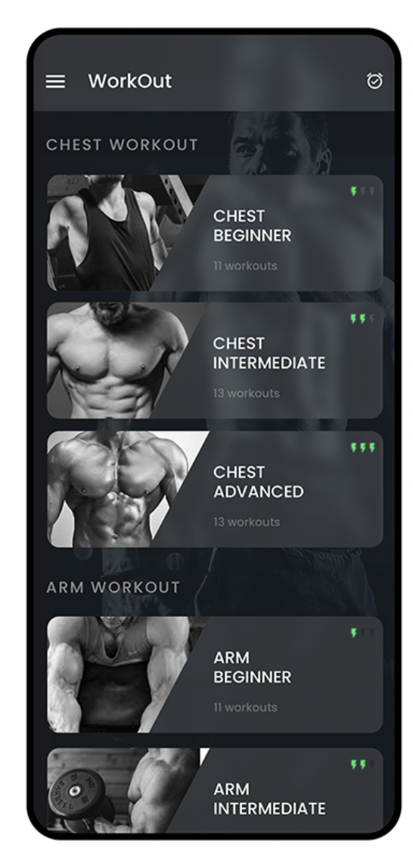
Functional Requirement - View Exercises By Muscle Group
Precondition: Home page
Basic Flow: User clicks on target muscle group ⇒ The user is presented with a sorted selection of exercises for that muscle group ⇒ The user can click on an exercise to view it in detail
Postcondition: Able to view various exercises for each muscle group, and can view each exercise individually

Slide 9
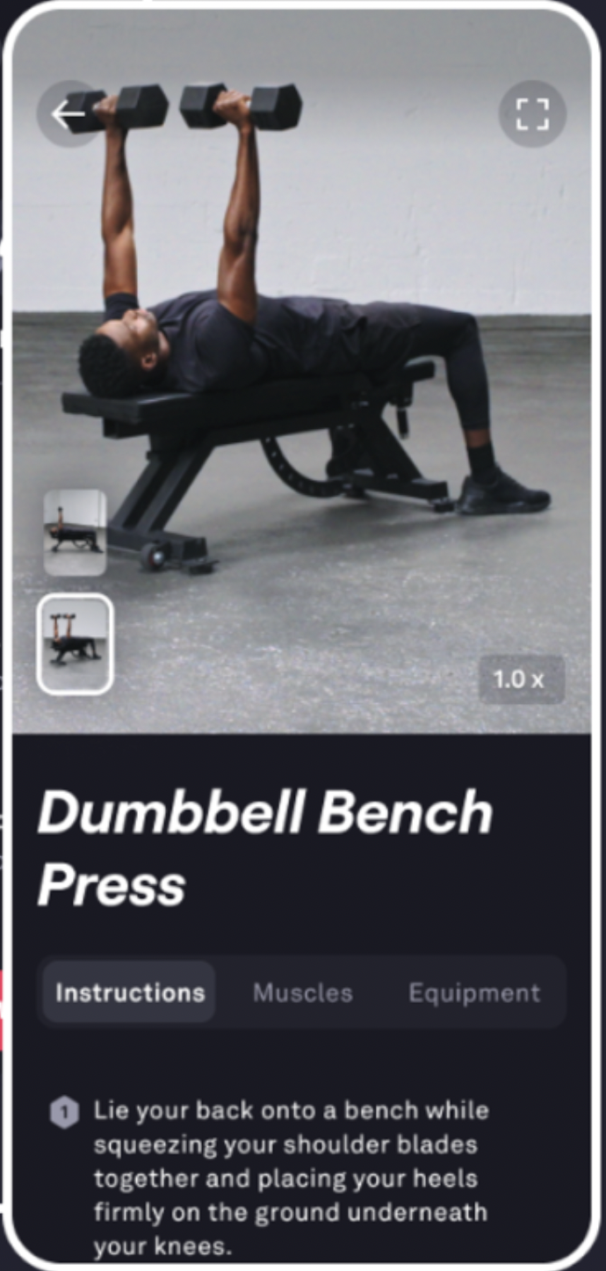
Functional Requirement - View Individual Exercise
Precondition: View exercises by a muscle group OR View exercises by favorites
Basic Flow: User selects an exercise ⇒ User can see the exercise name, description/instructions, the expected wait time, as well as a link to an instructional video ⇒ User can also favorite the exercise
Postcondition: Able to view exercise info as well as favorite an exercise

Slide 10
Functional Requirement - View Favorite Exercises
Precondition: Home page
Basic Flow: User views favorites ⇒ User is presented with a sorted selection of their favorited exercises ⇒ The user can click on an exercise to view it in detail
Postcondition: User is presented with all favorite exercises and can view each exercise individually

Slide 11
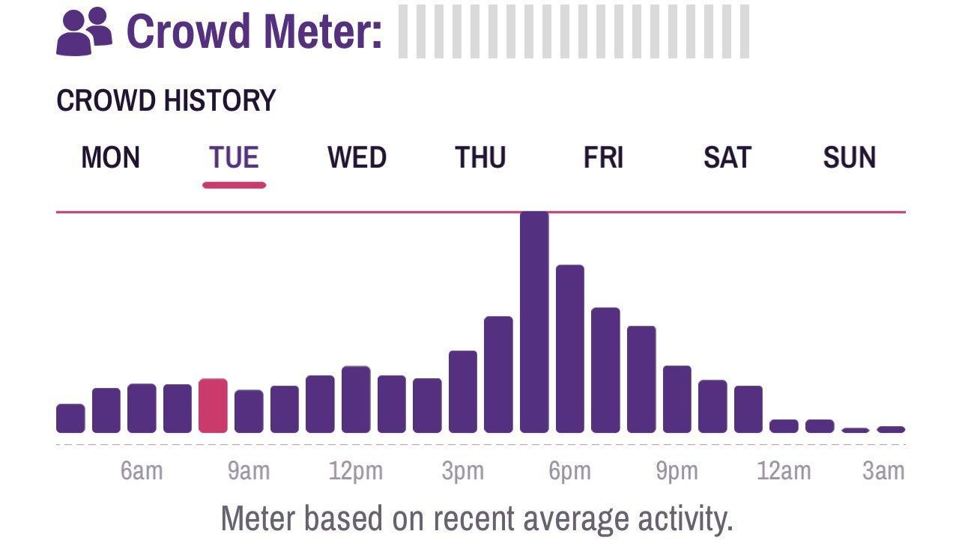
Functional Requirement - View Gym Crowd Level
Precondition: Home page
Basic Flow: The gym crowdedness is loaded upon login and is displayed on the home page (Gym crowdedness is taken from the gym counter in the gym) ⇒ Expected gym crowdedness for a time is displayed upon clicking the button
Postcondition: User can view the gym crowdedness

Slide 12
Functional Requirement - Log Out
Precondition: Logged in
Basic Flow: The user clicks the settings icon ⇒ The user clicks the logout button in the window ⇒ The user will also be logged out if the application is closed unless they chose to save their login info
Postcondition: The user is logged out and is brought back to the login page

Slide 13
Non-Functional Requirements
Efficient Exercise Sorting
Useful Notifications
User Reported Data Analytics
Network Security
User Data Privacy/Security
Efficient API Interactions

Slide 14
Non-Functional Requirements - Efficient Exercise Sorting
Once the selected muscle group is opened, it is important to have them sorted efficiently
In addition, it is important to have favorite exercises sorted efficiently

Slide 15
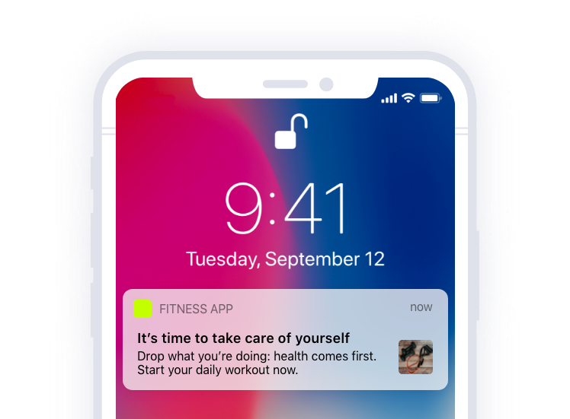
Non-Functional Requirements - Useful Notifications
To keep users engaged with the app we will have push notifications that send when the gym crowd level is below a certain point, or when it is lower than usual for the time.
Interacts with “View gym crowd level”

Slide 16
Non-Functional Requirements - Network Security
The network connection of the app needs to be secure, and protected
Applicable to all Functional Requirements

Slide 17
Non-Functional Requirements - User Data Security
The essential user data must be protected through encryption as well
Interacts with “Sign up”, “Log in”, and “Create user profile”

Slide 18
Non-Functional Requirements - Efficient API Interactions
Third party logins should not slow the app down
Applicable to “Sign up”, “Log in”, and “Create user profile”

Slide 19
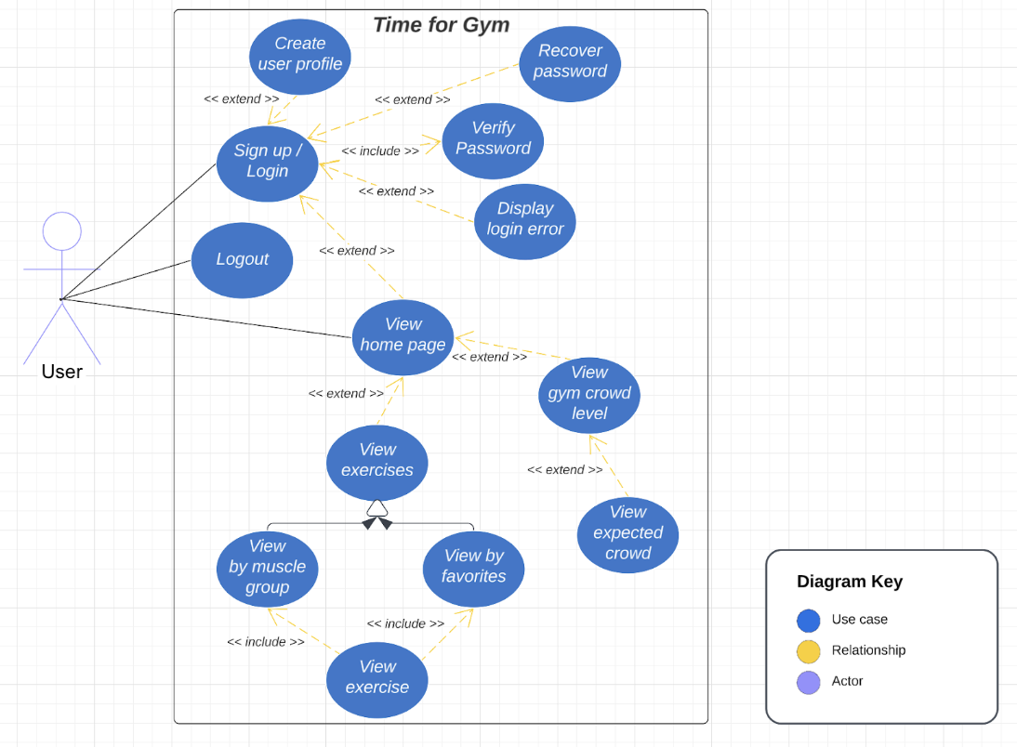
Use Case Diagram

Slide 20
Evolutionary Requirements
User Reported Data Analytics (Non-Functional Requirement)
To properly gauge wait times, there needs to be input from the users that tells us how many people are on each machine so we can get a baseline
User always will report busiest gym times to gauge how crowded the gym would be at any time during the week
Interacts to with “View exercise”

Slide 21
System Constraints
Mobile Application Framework Constraints
React will be used to deploy our backend and User Interface
Amazon Web Services
AWS will be used to allow for scalability and security for the app

Slide 22
Language Constraints
React Framework
A Javascript framework used to develop apps for several different mobile platforms. This will allow for efficient development and deployment on multiple platforms
Database Interactions Language
Using SQL will allow us to store and interact with user data and our own processes

Slide 23
Platform Constraints
Mobile Application Platforms
Android and IOS restrictions will constrain our development

Slide 24
Hardware Constraints
Mobile Devices
Common mobile device restrictions will also be our restrictions

Slide 25
Network Constraints
Internet Connection
To use the basic functions of the app an internet connection is essential

Slide 26
Deployment Constraints
Deployment to Respective App Stores
Every app store and platform will need to separately approve our app for release. Rules and regulations for each must be considered

Slide 27
Transition & Support Constraints
End of Project
When the class ends so will our project, unless another group is interested and willing to further advance our project

Slide 28
Budget & Schedule Constraints
Semester Timeline
Once the semester and this class end the project will end as well due to lack of budget and time

